Slide 1

NFC Antenna Electromagnetics
Austin W. Alex S. Dylan R. Joaquin S.

Slide 2
Background information
NFC – (Near Field Communication)
RFID – (Radio Frequency Identification)
Both refer to the same technology with the only difference being that RFID can communicate up to 100 meters while NFC communication is less than10cm.
NFC Antenna – Communication device
Transponder – Responds to wireless signals
NTAG Chip – Form of passive NFC chip, stores data without battery and uses magnetic fields as a power source
Smith Chart – A way to view the effective communication range of an antenna given a frequency. Good way of simulating what an ideal antenna would look like
Notes:
* Austin

Slide 3
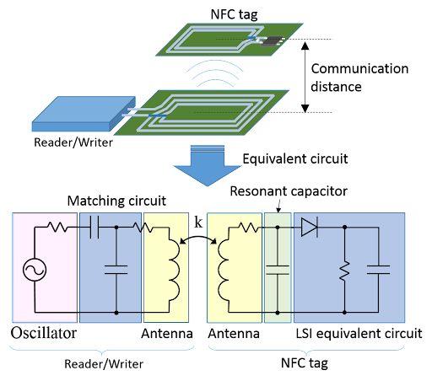
NFC Board Electromagnetics Overview
Notes:
Dylan
There are two main components to using NFC technology: an Antenna (shown above by the Reader/Writer) and the NTAG chip (Shown above by the NFC Tag)
The Antenna requires 3 main parts: The Antenna, the Matching Circuit, and the Oscillator.
The Oscillator sends out a periodic electronic signal which basically “Pings” the surrounding area in an attempt to try an read an NFC tag.
The Matching Circuit is used to transfer nearly all of the power in the circuit to the load of the circuit by using reactive components like capacitors (in this case, the Antenna is the load)
The Antenna in this case will then have nearly maximum power being transferred to it and generate a magnetic field. This magnetic field will induce a current in the antenna in the NTAG chip.
After a current is induced in the NTAG chip, the NTAG chip is powered and then begins to send its data back to the NFC Antenna where it will be read.
The Antenna was optimized to run at 13.56 MHz of frequency, and we used smith charts to concluded that our matching circuit and antenna would not only reach the specified 5 cm distance, but would also ensure maximum power transfer to the load.
Higher coupling coefficients allows for cleaner data transfer with no interference.

Slide 4
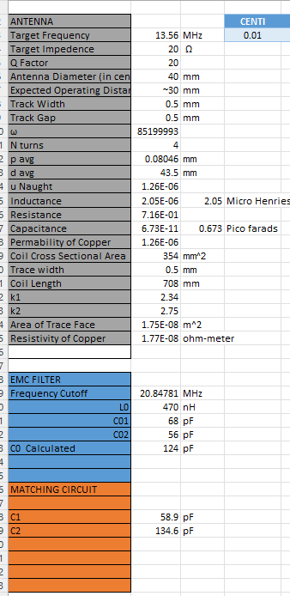
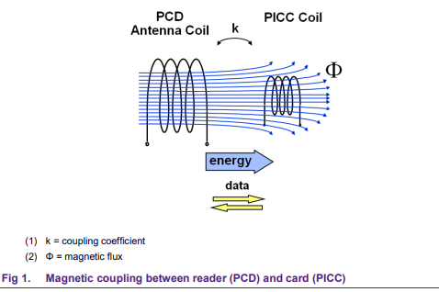
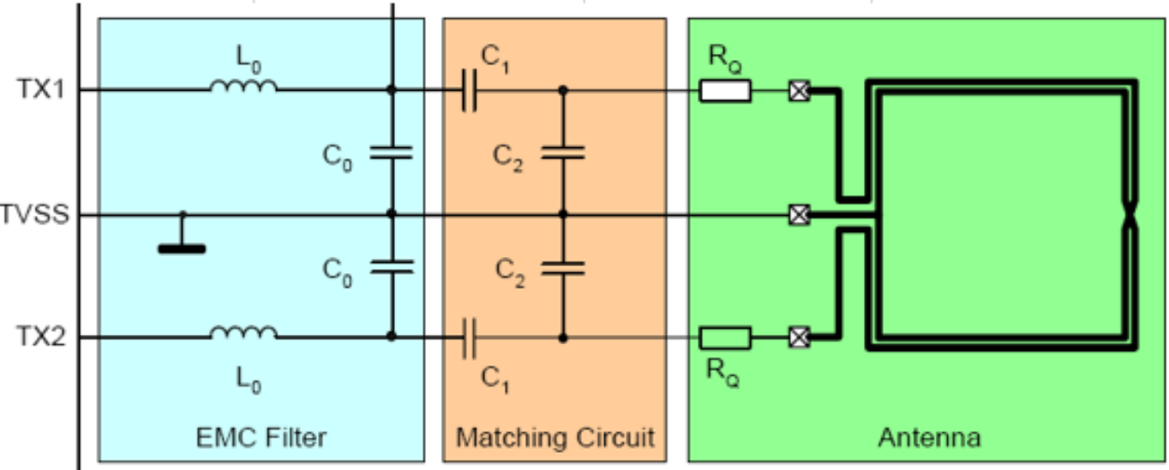
Antenna Calculations
Notes:
*Dylan
Through the use of NXP documents, we were given the general layout of how our entire NFC Antenna circuit should be pieced together and behave. Using the expected operating distance, antenna diameter, target Frequency, and target impedance: we were able to start solving for the needed component values in the overall circuit.
The requirements for making an antenna are that it is able to:
Generate a magnetic field to communicate a Card/NTAG Chip
Transmit data to and from the Card and Antenna
Matching circuits tend to work well when around 1 uL of inductance for short range applications, but depending on numbers of turns, can be more or less inductance.
Our calculations for each individual component took around a month and a half to calculate: afterwords we referenced simulations and antenna calculators we found to cross analyze our values and verify their authenticity.

Slide 5
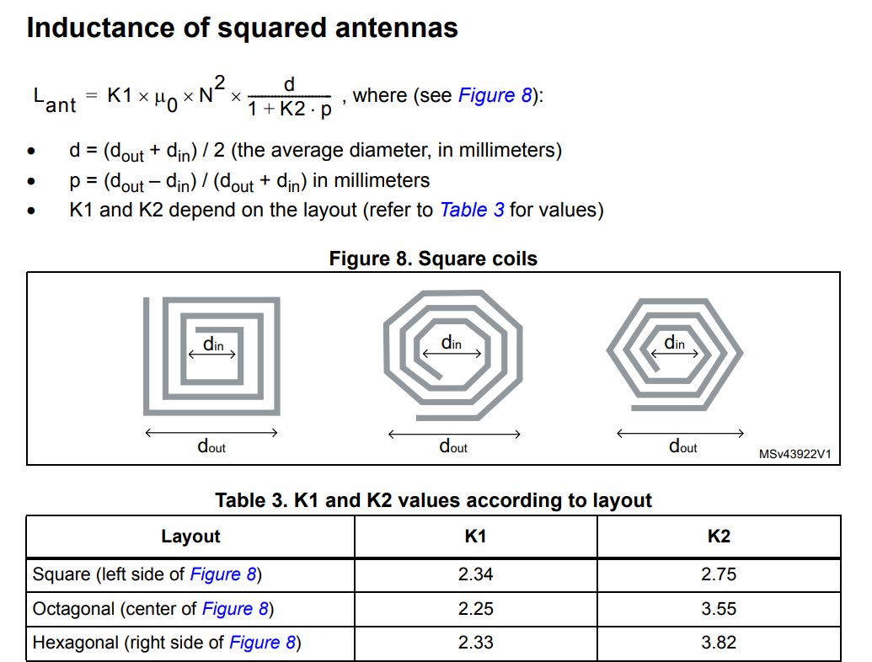
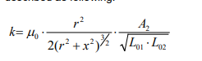
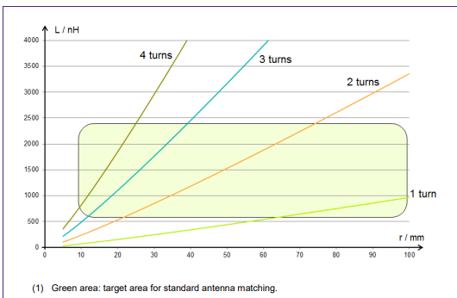
Antenna Shape & Size
The antenna shape determines stability
Square is more stable
Circle has less data loss
The antenna size determines the effective communication range
The antenna spacing between traces determines quality of data received
Coupling coefficient of Antennas
Numbers of turns
Optimal Matching circuit
Notes:
Alex
The optimal antenna shape, size and values can be easily derived from the Biot Savart Law which is derived for the operating distance specified. (i.e. the optimal Antenna size given the required operating distance)
We dug around and found a few research papers that dived into the optimal size and shape of NFC antennas. We found that more circular antennas prevent data loss from happening as easily while transferring the data where as square antennas were much more stable to control while being easier to implement effectively.
The size and spacing of the traces in the antenna determines the effective communication range as well as the quality of data received.
The coupling coefficient between antennas is a form of measurement that is a fraction of the magnetic flux that produced via the current in one antenna compared to the current of the other antenna.
The numbers of turns within the antenna changes the inductive load of the circuit which also modifies the matching circuit

Slide 6
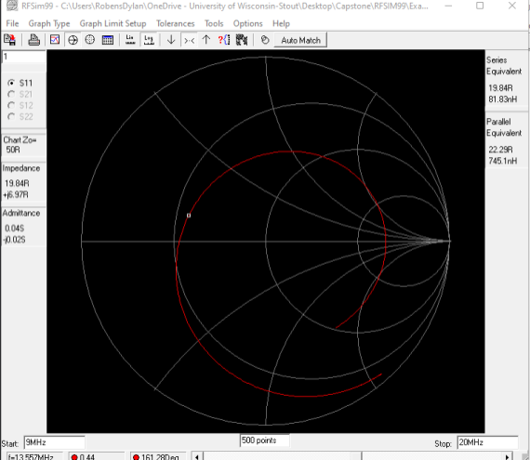
Smith Charts
Notes:
Austin
Above is the final smith chart simulation that we created for the antenna operating at 13.56 MHz, the frequency of the chips that we were trying to read and is what we used for the design moving forward.
How the smith chart works is as you move up and down from the center line, the system is more inductive or capacitive respectively
The same can be said for the resistance of the system, where the farther left you go the less resistance there is, and the farther right you go the more resistance in the system
These values are changed by swapping out the capacitors and resistors in the matching circuit to achieve our goal of 20-ohm impedance within the system
This is a very important step in antenna creation if you want to make a system as reliable and effective as possible, without this step we wouldn’t be able to guarantee that it hits that 13.56 MHz frequency and work for it’s intended purpose.

Slide 7
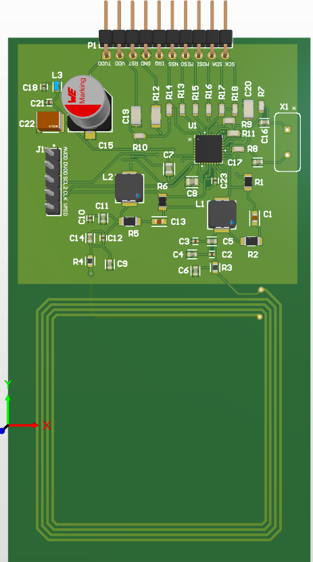
NFC Antenna design
After having the final values, set out to design the NFC PCB Board.
Designed through Altium Designer
Ordered as a pick and place PCB through JLPCB
Notes:
Alex
After having finished the calculations and antenna shape decisions, we implemented that into the final design of the antenna.
The antenna was made in the program Altium designer, and features multiple 0-ohm resistors throughout the design to “clean” the data as it’s passed through the antenna and reduce EMI in the system as a whole,
The antenna also features multiple debugging and testing headers, which are very important for a first draft design.
We ordered the antenna as a pick and place PCB through the manufacturer JLPCB due to the extremely small form factor that some of our components came in
By using this option, it took the guessing game of whether or not it was our soldering work that was causing the board issues out of the equation which was important to save time in the long run.

Slide 8
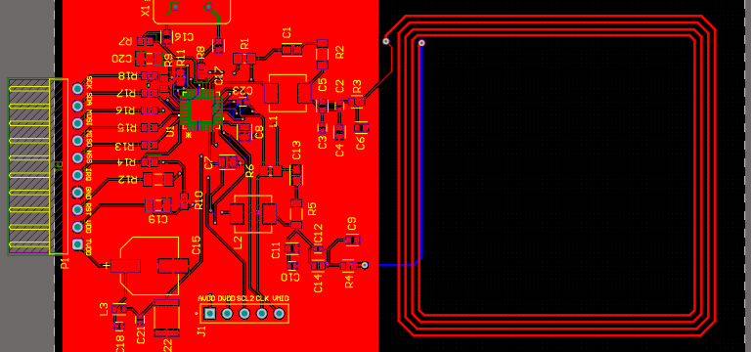


NFC Antenna design
Notes:
Alex
Blown up image of the 2D antenna design, point out the different aspects

Slide 9
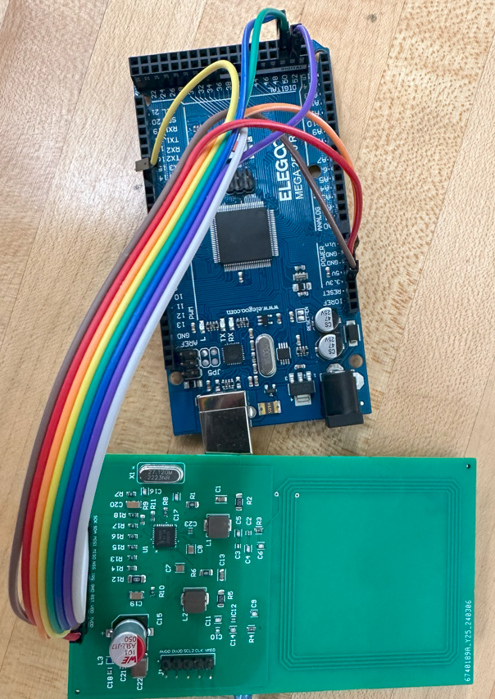
Testing the nfc antenna
After receiving the antenna started the debug phase
Tested multiple programs with the antenna
Very little open source programs that work with the CLR663
Discovered that the issue was a lack of programming
Notes:
Austin
After we ordered the antenna through JLPCB, it took roughly about 2 months for the board to get to Stout due to ordering the parts through global manufacturers and assembly.
Once it got here, we started right away on debugging the antenna and testing out all the individual components on the board.
What we found out really quickly, is that there are very few open-source programs that exist for the CLRC663, the NFC Reader chip that we selected in our design phase.
This meant that we had to spend a huge chunk of our development time trying to find a library that worked with our chip and reworking existing libraries to see if we could get them to work.
What we discovered at the end of development, is that we were able to correctly read and write to the registers that exist on the board itself, but due to a lack of a development board, we were unable to do anything with those registers.
In order to program this chip, we would have to order a development board from NXP, the CLRC663’s manufacturer.
Unfortunately, due to budget and time constraints, we were unable to order this board and program the chip to have the board working as desired.

Slide 10

Conclusions
NFC Reader design and implementation
How important timeframes are to meet deadlines
Manufacturer selection is very important
Created a board that we are confident is functional
Notes:
Dylan
Through this project, we learned about how antenna research, design, and implementation actually works and the how the physics that we learned here in college applies to that.
We also learned how important timeframes and multitasking are throughout the project, and making sure that you have a good plan going forward to meet those deadlines at the end of the day.
Manufacturer selection is very important when deciding who you want to create your board design, and if not chosen right can lead to unforeseen delays or even your design not working at the end of the day. While cheap does look nice on a bill, it’s not always the most economical decision for your project if you have to do multiple revisions in order to receive a working board.
While we did run into issues along the way and were not able to implement the NFC Reader that we designed into our final product presentation, we are confident that it does work due to the registers that we were able to recognize on the chip. Given more time and funding, we would be able to get this board to function as desired and make a second version that adds even more functionality to the board itself.

Slide 11

Questions?

